Slide 1
HR DATA ANALYSIS

Slide 2
In today’s competitive business landscape, effective human resource management is crucial for organizational success. This presentation delves into the analysis of key HR metrics, providing valuable insights into employee demographics, performance, compensation, and satisfaction. By examining factors such as salary distribution, employee tenure, gender diversity, and satisfaction levels, we aim to uncover trends and patterns that can guide decision-making and improve HR strategies. Through this data-driven approach, we can identify areas for improvement, optimize resource allocation, and enhance overall employee engagement and performance, ultimately contributing to the company’s growth and success.

Slide 3
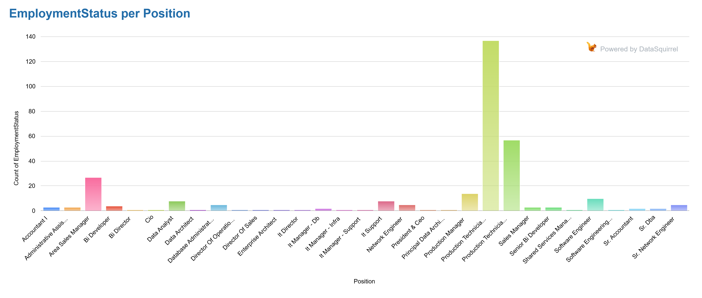

Slide 4
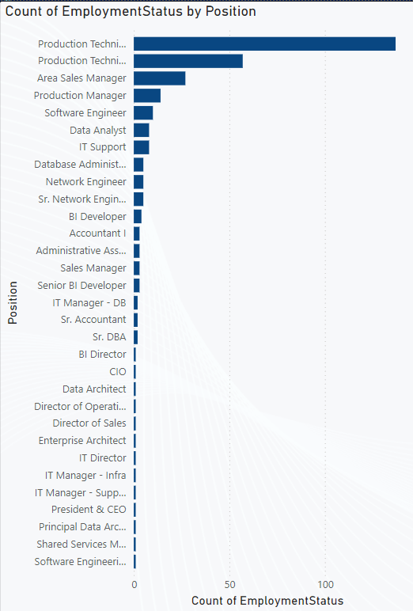
High Turnover in Production Technician I and II Roles
Production Technician I shows high numbers of both active employees (85) and voluntary terminations (45). The voluntary termination rate here is over 50% (45 out of 130), which could indicate that employees in this role may not be satisfied or that there are challenges around retention in this specific position.
Similarly, Production Technician II has a high voluntary termination count (26) relative to the active count (31), indicating a potential issue with retention for this role as well.
Sales and Managerial Roles
Area Sales Manager has a moderate number of active employees (23), but there's a noticeable amount of voluntary terminations (2) and terminations for cause (2).
Similarly, Production Manager and Sales Manager have relatively low headcount with some voluntary terminations, which may reflect dissatisfaction in higher-level roles as well. Further investigation into compensation, job satisfaction, and workload would be useful.
Terminations for Cause
Production Technician I and Database Administrator roles also have some terminations for cause (7 and 3, respectively), which may indicate challenges related to performance or behavior issues. The data shows a few cases in higher roles such as Enterprise Architect (1) and Software Engineer (1) which could be worth investigating further to understand the reason behind these terminations.

Slide 5
Position | EmploymentStatus | Count of EmploymentStatus | Position2 | EmploymentStatus3 | Count of EmploymentStatus4
Production Technician I | Active | 85 | Administrative Assistant | Active | 1
Production Technician I | Voluntarily Terminated | 45 | Administrative Assistant | Terminated for Cause | 1
Production Technician II | Active | 31 | Administrative Assistant | Voluntarily Terminated | 1
Production Technician II | Voluntarily Terminated | 26 | BI Director | Active | 1
Area Sales Manager | Active | 23 | CIO | Active | 1
Production Manager | Active | 9 | Data Architect | Active | 1
IT Support | Active | 8 | Director of Operations | Active | 1
Production Technician I | Terminated for Cause | 7 | Director of Sales | Active | 1
Data Analyst | Active | 6 | Enterprise Architect | Terminated for Cause | 1
Software Engineer | Active | 6 | IT Director | Active | 1
Sr. Network Engineer | Active | 5 | IT Manager - DB | Active | 1
BI Developer | Active | 4 | IT Manager - DB | Voluntarily Terminated | 1
Network Engineer | Active | 4 | IT Manager - Infra | Active | 1
Production Manager | Voluntarily Terminated | 4 | IT Manager - Support | Active | 1
Accountant I | Active | 3 | Network Engineer | Voluntarily Terminated | 1
Database Administrator | Terminated for Cause | 3 | President & CEO | Active | 1
Senior BI Developer | Active | 3 | Principal Data Architect | Voluntarily Terminated | 1
Software Engineer | Voluntarily Terminated | 3 | Production Manager | Terminated for Cause | 1
Area Sales Manager | Terminated for Cause | 2 | Sales Manager | Voluntarily Terminated | 1
Area Sales Manager | Voluntarily Terminated | 2 | Shared Services Manager | Active | 1
Data Analyst | Voluntarily Terminated | 2 | Software Engineer | Terminated for Cause | 1
Database Administrator | Active | 2 | Software Engineering Manager | Active | 1
Sales Manager | Active | 2 | Sr. DBA | Active | 1
Sr. Accountant | Active | 2 | Sr. DBA | Voluntarily Terminated | 1
Understaffed Positions
Some roles have a very low count, like BI Director (1), CIO (1), President & CEO (1), Software Engineering Manager (1), and Sr. DBA (1). The small headcount in these positions may make it challenging to ensure adequate backup, succession planning, or employee support. Understanding whether these roles are critical or whether they could benefit from cross-training might be useful.
Employee Retention Risk
Software Engineer has a mix of active employees (6) and voluntary terminations (3). This indicates a relatively higher attrition rate within this skill set, which may point to the industry-wide challenges in retaining tech talent.
IT Support and Network Engineer both have relatively small active counts (8 and 4, respectively) but no voluntary terminations, suggesting stable retention in these roles. However, further investigation into satisfaction and compensation would be worthwhile.

Slide 6
Job Satisfaction and Organizational Health
There is a clear indication that certain roles, particularly at the technician level (e.g., Production Technician I and II), have a higher voluntary turnover, which could point to issues with job satisfaction, compensation, or career advancement opportunities.
The presence of voluntary terminations in senior or managerial roles (e.g., IT Manager, Principal Data Architect) suggests that even higher-level employees are not immune to dissatisfaction.
Managerial and Technical Skill Gaps
The dataset indicates a relatively high proportion of managerial roles, such as IT Manager, Production Manager, Area Sales Manager, which are affected by voluntary terminations. This highlights a potential gap in management stability.
Similarly, technical roles like Software Engineers, BI Developers, and Network Engineers show a mixture of active employees and voluntary departures, which might indicate the challenge of retaining technical talent in competitive fields.
Role-Specific HR Strategies
Entry-level roles (e.g., Production Technician I) and technical roles (e.g., Software Engineers) may benefit from more robust onboarding, mentorship, and career progression opportunities to reduce voluntary turnover.
Managerial roles may need additional leadership training, performance feedback systems, and compensation reviews to reduce turnover in these positions.
Actionable Recommendations
Focus on understanding and addressing the root causes of voluntary terminations, especially in roles with high turnover like Production Technician I, Software Engineer, and Area Sales Manager.
Evaluate and enhance the retention strategies for technical roles by offering career development opportunities, recognition, and competitive compensation.

Slide 7
SUM OF SALARY BY POSITION AND GENDER
Position | Sum of Salary | Gender | Position2 | Sum of Salary3 | Gender4
Production Technician I | 46,54,771 | F | Director of Sales | 1,80,000 | F
Production Technician I | 29,52,041 | M | IT Director | 1,78,000 | M
Production Technician II | 24,19,722 | F | Senior BI Developer | 1,72,824 | M
Production Technician II | 12,79,134 | M | Director of Operations | 1,70,500 | M
Area Sales Manager | 9,87,657 | M | IT Manager - Infra | 1,57,000 | M
Area Sales Manager | 7,65,522 | F | Administrative Assistant | 1,56,840 | F
Production Manager | 6,16,443 | M | Data Architect | 1,50,290 | F
Software Engineer | 5,81,437 | F | IT Manager - Support | 1,38,888 | M
Data Analyst | 4,45,326 | M | Sales Manager | 1,34,728 | F
Production Manager | 4,37,680 | F | Accountant I | 1,27,523 | M
Database Administrator | 4,28,499 | F | Principal Data Architect | 1,20,000 | F
Software Engineer | 3,85,755 | M | Database Administrator | 1,13,999 | M
IT Support | 3,15,940 | F | BI Director | 1,10,929 | M
IT Manager - DB | 2,89,919 | M | Sr. DBA | 1,04,437 | M
BI Developer | 2,85,940 | M | Enterprise Architect | 1,03,613 | M
Sr. Network Engineer | 2,73,100 | M | Network Engineer | 1,03,349 | F
Data Analyst | 2,72,729 | F | Sr. DBA | 1,00,031 | F
President & CEO | 2,50,000 | F | BI Developer | 95,920 | F
CIO | 2,20,450 | F | Shared Services Manager | 93,046 | M
Sr. Accountant | 2,05,718 | F | Senior BI Developer | 81,584 | F
Network Engineer | 2,04,676 | M | Software Engineering Manager | 77,692 | M
IT Support | 1,93,535 | M | Sales Manager | 72,992 | M
Sr. Network Engineer | 1,92,254 | F | Accountant I | 63,000 | F

Slide 8
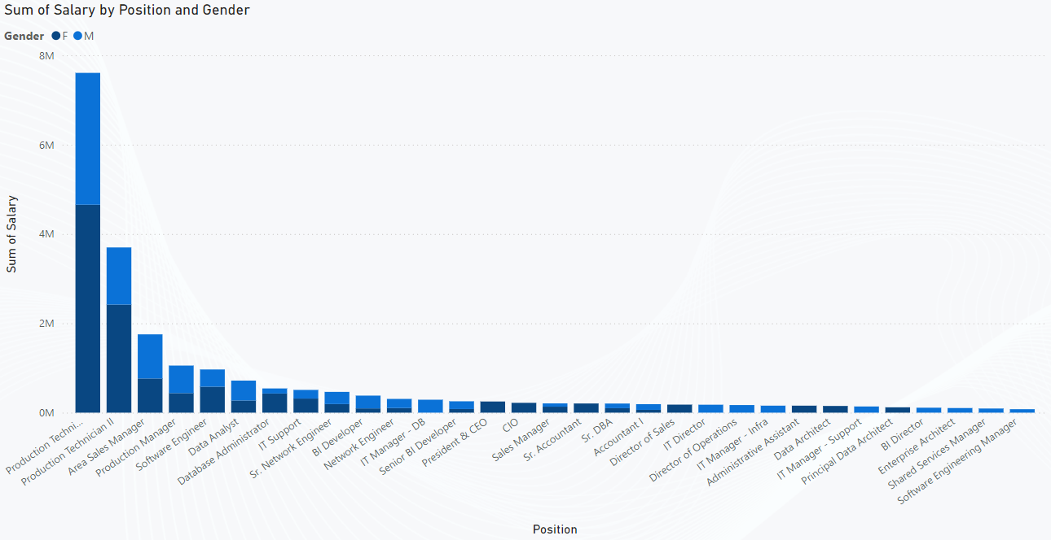
The dataset reveals a significant disparity in total salaries between genders across various positions. For instance, positions like Production Technician I and Production Technician II show a notable difference in total salaries, with females earning a total of 4,654,771 and 2,419,722 compared to males at 2,952,041 and 1,279,134, respectively. This highlights the importance of addressing potential gender-based wage gaps within the organization.
High-paying positions like Area Sales Manager, President & CEO, and CIO are typically held by males, which suggests a potential leadership disparity across genders at the top levels. However, positions like Production Technician I and IT Support have more balanced gender distribution in terms of salaries, although a deeper look could reveal specific inequalities in compensation for similar roles.

Slide 9
The highest salary allocations are concentrated in managerial and executive positions, such as President & CEO, CIO, and Area Sales Manager, which have higher overall sums in comparison to technical roles such as IT Support or Database Administrator. This indicates a salary stratification based on position, where leadership roles command the highest compensation.
A clear trend emerges where men dominate in technical and managerial roles, such as Software Engineer, BI Developer, and IT Director. On the other hand, women tend to be more concentrated in roles like Administrative Assistant, Sales Manager, and Production Manager. Understanding these trends can help the company design strategies for promoting diversity and inclusion in different departments.
The dataset shows that employees in higher-paying roles such as President & CEO or IT Directors are likely to remain with the company for longer durations. In contrast, positions like Accountant I and Sales Manager with lower salary sums might suggest either high turnover or under-recognition of those employees. Identifying factors leading to this can help improve employee retention strategies.
By examining the sum of salaries and gender distribution in roles, the company can tailor compensation packages to improve equality, attract top talent, and retain high-performing employees. It’s also essential to assess whether the salary distribution aligns with industry standards, especially for roles like Data Analyst, Software Engineer, and Network Engineer, where high-demand skills are often associated with higher pay.

Slide 10
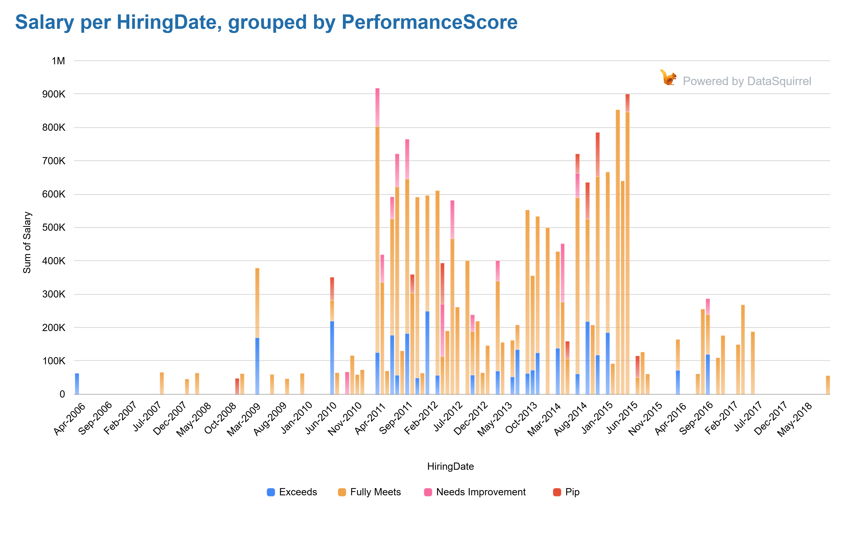
SUM OF SALARY AND COUNT OF PERFORMANCE SCORE BY DEPARTMENT

Slide 11
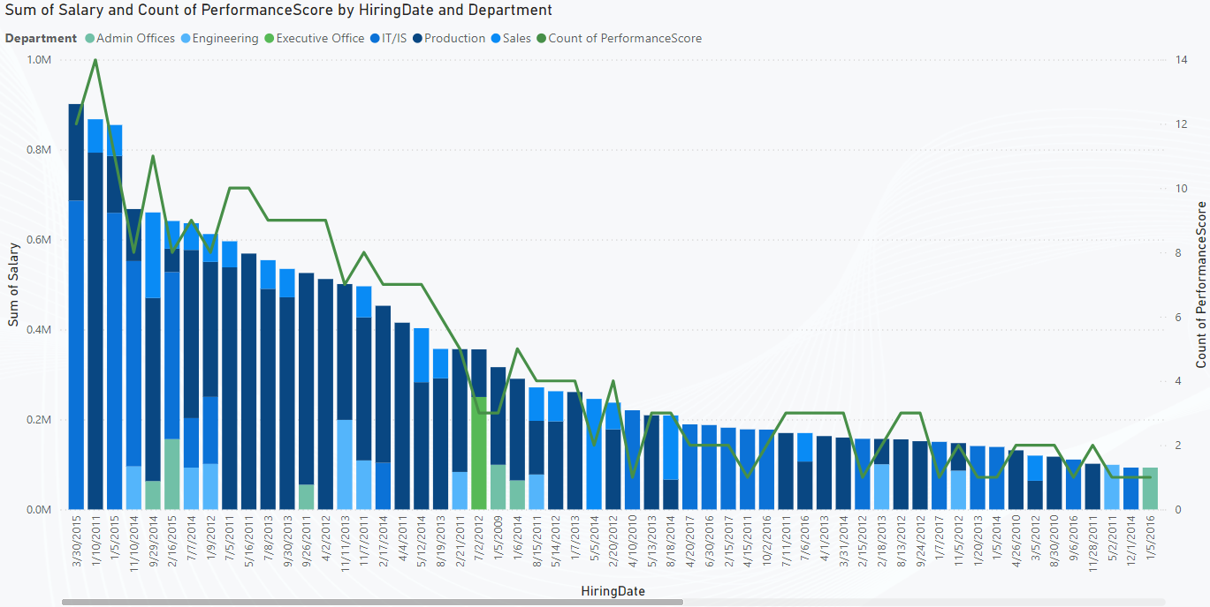
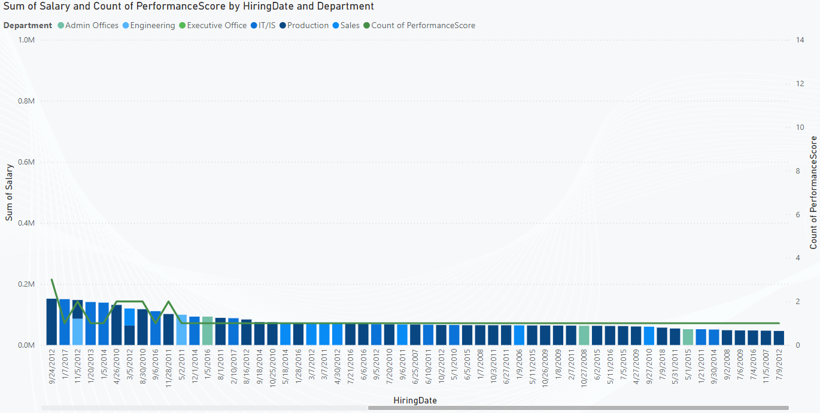
Production has the largest number of employees, which is reflected in the high total salary sum (793,090), as well as the significant variation in performance scores. The department shows a range of employees from those with high salaries (e.g., higher sum salaries for longer-tenured employees) to those with lower salaries. This could indicate that salary and performance may vary significantly based on seniority, job role, or tenure in the company.
IT/IS employees show a moderate salary sum (e.g., 686,580 in one record) but have a smaller number of employees (compared to Production), suggesting that salaries in IT may be relatively competitive but the department may be smaller or newer.
The hiring dates reveal that the company has employees from various hiring years, which can provide insights into employee retention and turnover. For example, several employees have been with the company since 2011, while others were hired as recently as 2017. The data also reflects different salary levels that may be associated with tenure. Older employees tend to have higher salaries, which could reflect salary increments, promotions, or the experience of long-term staff.
It is essential to analyze whether employees who joined earlier (in 2010–2015) are receiving adequate raises or whether the company might be falling behind on competitive pay in newer years, potentially causing retention issues.

Slide 12
The performance score for employees varies greatly, with some employees receiving low scores (as low as 1), while others have higher scores (up to 13). This disparity in performance scores across departments suggests that HR should analyze whether there are any departmental trends.
The data allows for exploring the correlation between salary and performance scores. For example, employees with higher salaries tend to have higher performance scores (such as in the case of long-tenured employees in Production and IT/IS). If employees with lower salaries have consistently low performance scores, HR could investigate whether compensation is a contributing factor to performance.
The Sales and Engineering departments have a small number of employees, but these employees seem to have lower performance scores overall, with many employees scoring 1 or 2. HR may want to focus on improving performance in these departments through training, mentorship, or even restructuring job roles to increase employee engagement and performance.
There seems to be a large salary disparity among employees with similar hiring dates or in the same department. For example, an employee hired in 2011 may have a salary of $793,090 or as low as $47,750. These discrepancies could be the result of variations in job roles, promotions, or even compensation inequities. This is an opportunity for HR to review compensation policies to ensure fairness and transparency in salary determination.
The dataset could provide insights into the effectiveness of the company’s promotion strategies. For example, a review of employees' performance scores over time could indicate if those with high performance are being promoted effectively. If not, it may signal gaps in internal promotion policies or talent management strategies.

Slide 13
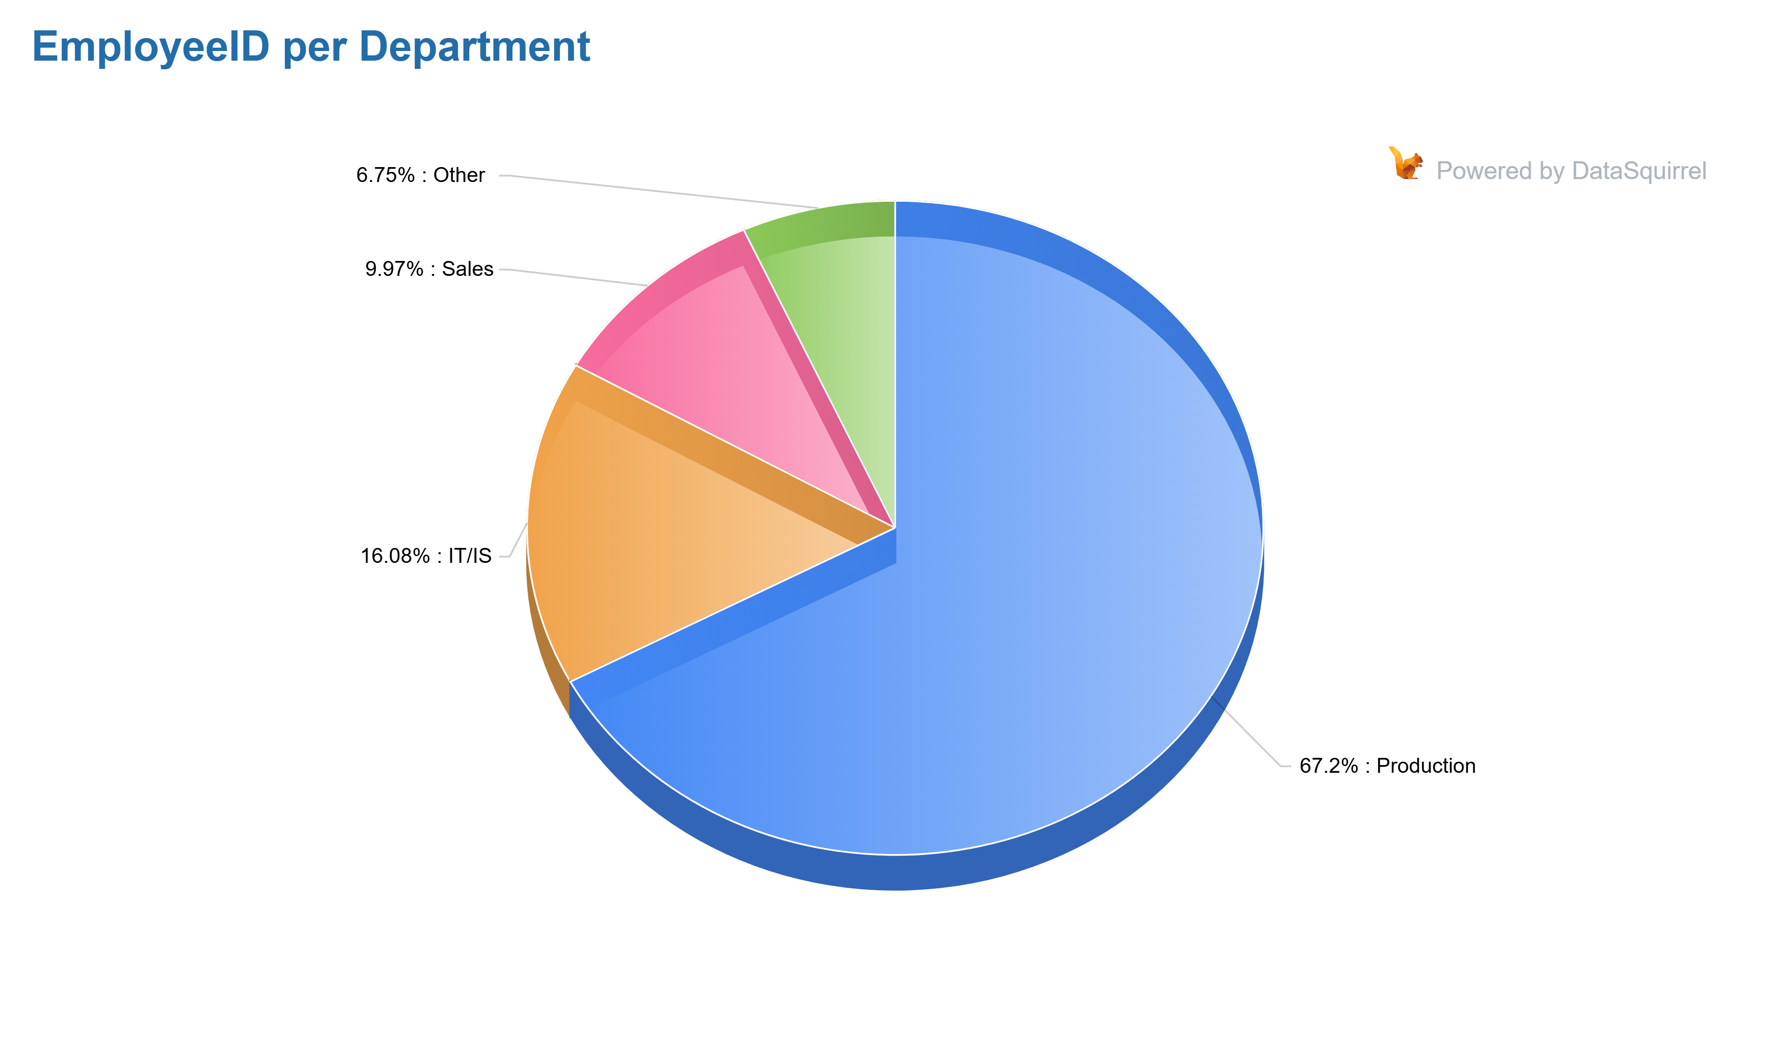
COUNT OF EMPLOYEES BY DEPARTMENT
Department | Count of EmployeeID
Production | 209
IT/IS | 50
Sales | 31
Engineering | 11
Admin Offices | 9
Executive Office | 1
The Production department is by far the largest, with 209 employees, indicating that it is likely the core operational area of the company. This could mean the company has a strong emphasis on production or manufacturing, which may require further workforce management strategies to ensure optimal efficiency and satisfaction.
IT/IS comes next with 50 employees, a relatively large number, reflecting the company's investment in technology and information systems. The size of this department suggests it plays a critical role in supporting the company's digital infrastructure.
Sales and Engineering departments are smaller, with 31 and 11 employees, respectively. These departments might benefit from further growth or optimization depending on the company’s strategic goals, particularly in driving revenue and innovation.

Slide 14
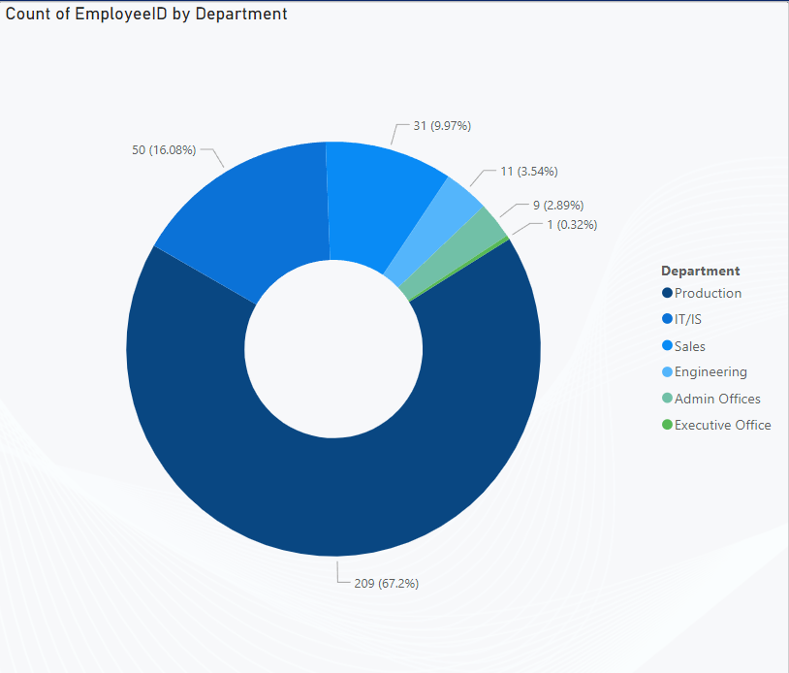
Admin Offices have 9 employees, a small but essential team, likely responsible for supporting the rest of the organization in administrative functions.
The Executive Office has only 1 employee, indicating that the senior leadership is relatively small, or perhaps the role includes multiple responsibilities or is part of a broader team.
A significant portion of the workforce (around 65%) is in the Production department, which may create challenges in terms of workforce engagement, communication, and retention if not managed properly. Employee satisfaction in such a large group should be a focus to prevent turnover and burnout.
IT/IS with 50 employees is a sizable group, indicating that technology support and development are vital to the business, which could necessitate ongoing training and professional development to keep pace with tech trends.
Sales and Engineering departments are relatively small, which could limit capacity for scaling efforts in these areas. If the company plans to expand, they may need to invest in growing these departments or diversifying their skill sets.
If the company plans for growth, there could be a need to scale departments like Sales, Engineering, and Admin Offices. HR should be prepared to develop strategies for recruiting, onboarding, and retaining employees as these areas expand.

Slide 15
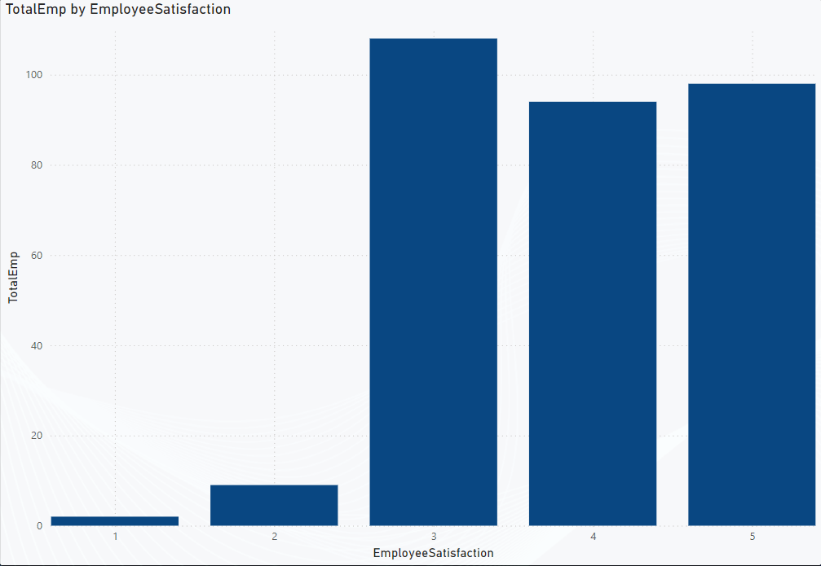
EMPLOYEE SATISFACTION
EmployeeSatisfaction | TotalEmp
1 | 2
2 | 9
3 | 108
4 | 94
5 | 98
The dataset shows a general trend of most employees falling into the 3 (Neutral) to 4 (Satisfied) satisfaction levels, with a substantial portion of employees (108) at satisfaction level 3, and 94 employees at level 4. This suggests that a significant portion of the workforce is either neutral or satisfied with their current roles, indicating room for improvement or targeted efforts to increase satisfaction across the board.
There is a direct correlation between higher satisfaction levels and higher total employee counts. For instance, satisfaction levels 3 (Neutral) and 4 (Satisfied) have the highest number of employees (108 and 94, respectively). This suggests that employees who are at least neutral or satisfied with their roles tend to stay within the organization.
HR may need to investigate why satisfaction level 5 (Highly Satisfied), which would be the most desirable level, has fewer employees. It could indicate that while employees are generally satisfied, there may be a lack of programs or incentives to push satisfaction to its peak. Focusing on the areas that contribute to high employee satisfaction could be an area of focus.

Slide 16
The fact that there are 2 employees in the satisfaction level 1 category is a red flag. This could be a significant indicator of underlying problems in the workplace, such as poor management, inadequate resources, or work-life imbalance. HR should take immediate action to investigate the root causes of dissatisfaction among these individuals and develop an action plan to address their concerns.HR can develop targeted engagement programs specifically for employees in the satisfaction level 3 group (Neutral), as this is the largest group. These programs could focus on improving communication, providing opportunities for development, and creating a more inclusive and supportive work environment. Engaged employees are more likely to move up to higher satisfaction levels, benefiting both employee retention and productivity.
Address Low Satisfaction: HR should conduct in-depth follow-ups with employees in satisfaction level 1 to understand the causes of dissatisfaction and work on resolving the issues to prevent turnover.
Improve Engagement in Neutral Groups: Programs designed to transition Neutral (3) employees to Satisfied (4) employees could be highly beneficial. Focus on creating opportunities for skill development and career progression.
Regular Feedback Mechanisms: HR should implement continuous feedback mechanisms, such as pulse surveys or regular one-on-one check-ins, to track and respond to satisfaction levels proactively.
Foster a Culture of Recognition: More recognition and appreciation programs may help increase the number of employees in satisfaction level 5 (Highly Satisfied), ensuring that the organization is fostering a motivated and happy workforce.

Slide 17
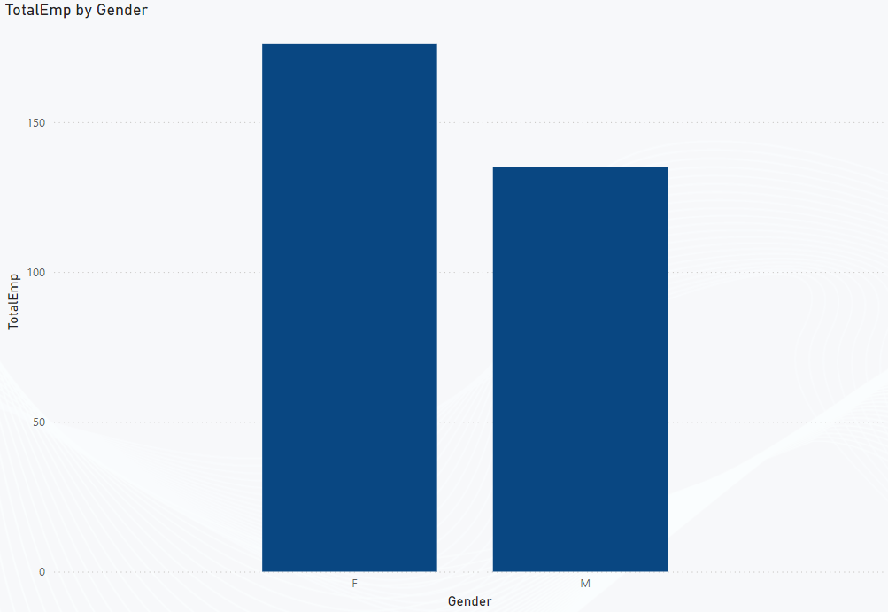
GENDER RELATED TO EMPLOYEE SATUS
Gender | TotalEmp
F | 176
M | 135
The dataset shows a higher number of female employees (176) compared to male employees (135), which indicates a gender-balanced workforce, with females comprising a larger portion of the total employees.
This distribution could be useful when analyzing diversity and inclusion initiatives within the company, as it suggests that gender diversity is already present. HR may want to explore whether gender diversity is represented equally across different departments and roles, or if there are certain areas where one gender dominates.

Slide 18
Understanding the gender distribution in relation to turnover rates can be valuable. If there is a significant gender gap in employee retention, HR can explore the reasons behind it. For example, are there specific challenges that male or female employees face differently in the workplace? Analyzing exit interview data could shed light on this.
It could also be insightful to evaluate if there are any gender-based patterns in employee satisfaction scores. Are male employees generally more satisfied than female employees (or vice versa)? This could indicate areas where gender-specific interventions may be necessary.
In summary, the gender distribution of employees provides valuable insights into diversity levels, talent management, and employee engagement within the organization.
HR can leverage this data to: Ensure gender equity in various organizational functions (pay, career growth, leadership roles). Develop initiatives aimed at improving inclusion and fostering an environment where all employees, regardless of gender, feel valued and supported. Address potential gender-specific issues that may arise in retention, satisfaction, or career development to maintain a fair, inclusive, and productive workplace.

Slide 19
BUSINESS IMPROVEMENT INSIGHTS:
Address Gender Pay Disparity: The gender-based salary differences point to the need for a review of compensation policies to ensure equitable pay across all genders, especially in leadership and technical roles. Implementing regular salary audits and transparency in pay scales can reduce gender bias.
Enhance Talent Retention Strategies: Certain high-salary positions (e.g., IT Managers, Senior Engineers) should be prioritized for retention strategies, including mentorship, career development programs, and competitive compensation packages to reduce turnover and retain top talent.
Focus on Leadership Diversity: The dataset suggests an underrepresentation of women in higher-paying, leadership, and technical positions. Targeted recruitment efforts, mentorship programs, and inclusive leadership development opportunities could foster greater gender diversity in senior roles.
Optimize Salary Structure: The company could benefit from a more structured salary progression system that aligns with market benchmarks and internal equity. Regular salary reviews and performance-based pay increases can help maintain competitiveness and employee satisfaction.
Implement Data-Driven HR Policies: Using data analytics to track employee satisfaction, performance, and career progression can help HR design more personalized development plans and interventions, enhancing employee engagement and organizational growth.

Slide 20
CONCLUSION
The analysis of the HR dataset reveals important insights into salary distribution, gender representation, and role-specific compensation trends within the organization. Key findings highlight a gender pay gap, with males generally earning higher salaries, especially in leadership and technical positions. Additionally, certain roles are concentrated with higher salary sums, suggesting the need for strategic talent management and compensation alignment. To foster a more inclusive and equitable workplace, it's essential for the organization to explore ways to address these disparities, implement diversity and inclusion initiatives, and ensure fair career progression for all employees. By leveraging these insights, HR can refine its policies to support employee retention, promote equality, and enhance overall organizational performance.

Slide 21
THANKYOU

